Slide 1
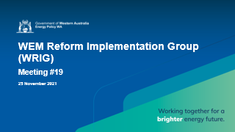
WEM Reform Implementation Group (WRIG)
Meeting #19
25 November 2021

Slide 2
Housekeeping
Ground rules and virtual meeting protocols
Please place your microphone on mute, unless you are asking a question or making a comment.
Please keep questions relevant to the agenda item being discussed.
If there is not a break in discussion and you would like to say something, you can ‘raise your hand’ by typing ‘question’ or ‘comment’ in the meeting chat. Questions and comments can also be emailed to wrig@energy.wa.gov.au after the meeting.
The meeting will be recorded for minute-taking purposes. Please do not make your own recording of the meeting.
Please state your name and organisation when you ask a question to assist with meeting minutes.
If there are multiple people dialling in through a single profile, please email wrig@energy.wa.gov.au with the names of the attendees to be recorded in the minutes.
If you are having connection/bandwidth issues, you may want to disable the incoming
and/or outgoing video.

Slide 3
Agenda
9:30am | Item 1: Introductions Dora Guzeleva | EPWA
9:35am | Item 2: Joint Industry Plan – Updates Dora Guzeleva | EPWA Mariusz Kovler | AEMO Mark McKinnon | Western Power Ben Connor | Synergy
9:45am | Item 3: Update on the “Reformer” Portal for Participants Mike Reid | AEMO
9:55am | Item 4: Procedure Updates Alex Gillespie, Christopher Wilson, Stuart MacDougall, Rebecca Petchey | AEMO
10:50am | Item 5: Extending the scope for transitional procedure development Dora Guzeleva | EPWA
11:00am | Item 6: GPS Update Mike Chapman| Western Power
11:10am | Item 7: Next Steps Dora Guzeleva | EPWA

Slide 4
Joint Industry Plan Updates
Session purpose: EPWA, AEMO, Western Power and Synergy to update WRIG on key changes to the JIP

Slide 5
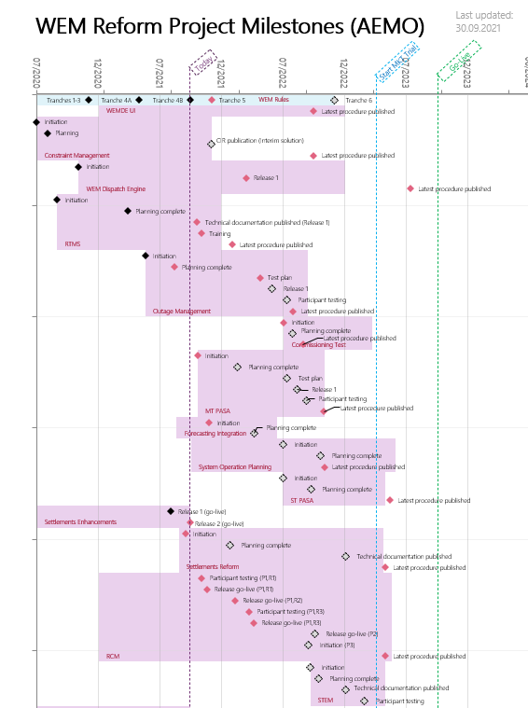
Joint Industry Plan
Updates and run through
EPWA, AEMO, Western Power and Synergy to run through key milestones, status and changes in JIP.
Updated JIP and Milestone log will be circulated/published alongside WRIG Meeting Minutes.
JIP and log are published to: https://www.wa.gov.au/government/document-collections/wem-reform-implementation-group-wrig
Please note: To accommodate changes to the WEM Procedures timetable, AEMO expects to finalise the JIP updates Wednesday 1 December.

Slide 6
AEMO Implementation Program Activities
Progress since last WRIG
      RCM Phase 1 – Release 1 CRC applications in RCM Portal deployed to the RCM Production environment 24 Nov 2021
      RTMS – delivered two RTMS Interactive Showcases to Participants, and undertook ongoing system development work
      WEMDE Project – Core engine constructed; minor work remaining
      Outage Management – progressing with building the system for participant submission of Outage Plans, including UI.
      Completed review of market feedback on WEM Procedures and subsequently published: Communications and Control Systems; FCESS Accreditation
Next Steps
Complete first stage of development of system for participant submission of Outage Plans (Jan 2022)
Continue work on provisioning WEMDE with upstream data feeds
Provide the Market with preliminary guidance on WEMDE dispatch outcome data (Dec WRIG-IT)
Draft specification for the format of Dispatch Instruction supplied to Market Participants (Q1 2022)
Present to January WRIG on the WEM Procedure: Real-Time Market Submissions (Jan 2022).
Release RTMS system to Market Test (Feb 2022).
RCM Phase 2 (NAQ) Investment Brief to be signed off December 2021
RCM Phase 2 (NAQ) system development to commence December 2021
Complete provision planning for Registrations and Settlements – subject to resolution of the WEM Rules (Jan 2022)

Slide 7
AEMO – Market Readiness update
Readiness Working Group (next meeting 14 December)
  Will consider specific readiness criteria for Western Power (targeting Q1 2022 to publish the full set of specific readiness criteria for Market Participants, Western Power, ERA and AEMO)
  Refined industry risk register (to be published through the Reformer Portal this year)

Slide 8
Rules Gazettal Schedule
Work package | June | July | August | Sept | Oct | Nov | Dec | 2022
TRANCHE 0 - GAZETTED Governance of constraints Technical Rules change management, etc
TRANCHE 1 - GAZETTED Generator Performance Standards Framework Frequency Operating Standards and Contingency Events Frameworks
TRANCHE 2 - GAZETTED Foundation Market Parameters (incl. STEM) Frequency Co-optimised ESS Scheduling and Dispatch Market Settlement, etc
TRANCHE 3 - GAZETTED Reserve Capacity Mechanism (RCM) Prioritisation and Network Access Quantities Framework Participation of storage/hybrid facilities in the RCM, etc
TRANCHE 4A - GAZETTED Transitional Arrangements (e.g. ESS accreditation) Changes and Rules commencement to facilitate 2021 RCM, etc.
TRANCHE 4B – GAZETTED (28 September) UFLS & System Restart Change management for specified Technical Standards Changes to shortfalls/refunds – not-in-service capacity and ESR Remaining changes to facilitate 2021 and 2022 RCM Changes and Rules commencement to facilitate 2022 RCM
TRANCHE 5 (December) Non-Cooptimised ESS Framework Participation and Registration framework Intermittent Loads Changes to RCOQ and Reserve Capacity testing rules Market Information Framework (tbc)
TRANCHE 6 (2022) Typographical & Reference Errors Manifest errors / omissions |  |  |  |  |  |  |  | Timing TBC
Drafting instructions and rule drafting | Stakeholder consultation | Ministerial approval, publication of the Amending Rules and Gazettal
Notes:
Stu to encourage an update from Dora.

Slide 9
Update on the “Reformer” web portal
Session Purpose: To update the group on establishment of the new WEM Reform portal for WEM participants

Slide 10
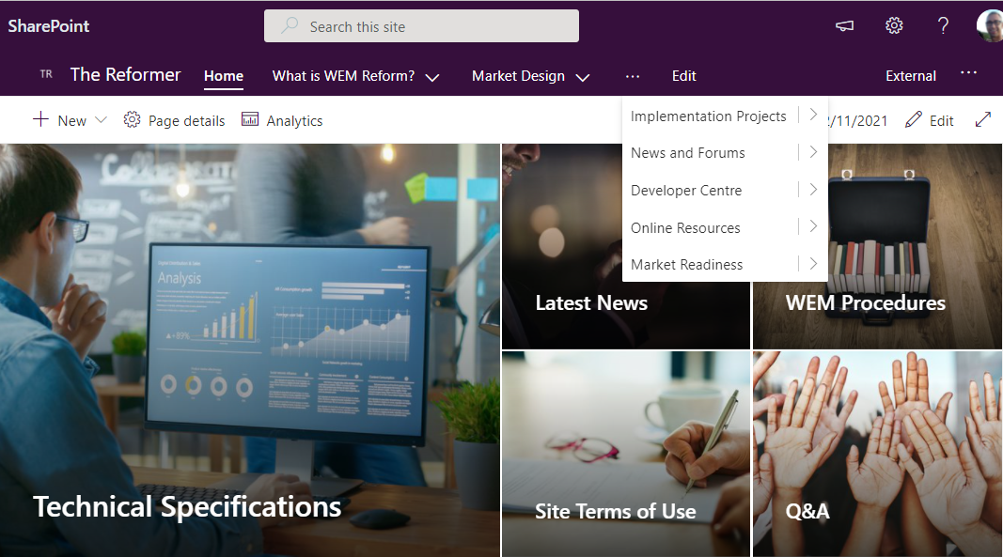
Update on “the Reformer”
Site is now established and built out
Content is undergoing internal approvals
We’ll issue invitations to register for access as soon as possible

Slide 11
WEM Procedures
Session purpose:
AEMO to provide an overview of the Dispatch Algorithm and Capacity Credit Allocations
AEMO to discuss feedback received for the Certification of Reserve Capacity for the 2021 Reserve Capacity Cycle WEM Procedure

Slide 12
WEM Procedures
WRIG Schedule
Meeting | Owner | Project | Topic/Procedure
25 November | AEMO | WEMDE | Dispatch Algorithm
 | AEMO | Settlements | Capacity Credit Allocations
 | AEMO | RCM | Certification of Reserve Capacity for the 2021 RC Cycle Feedback
27 January | AEMO | RCM | RCM Constraints
 | AEMO | RCM | RCM Limit Advice
 | Western Power | RCM | Providing RCM Limit Advice
 | AEMO | RCM | Certification of Reserve Capacity
 | AEMO | RCM | Indicative Facility Class and RCM Facility Class Assessment Update and Feedback
24 February | AEMO | RCM | RCM Constraints Feedback
 | AEMO | RCM | RCM Limit Advice Feedback

Slide 13
WEM Procedures
Upcoming Publication
Date | Owner | Project | Procedure
1 December | AEMO | RCM | Indicative Facility Class and RCM Facility Class Assessment
1 December | AEMO | RCM | Facility Sub-Metering
Upcoming Consultation
Date | Owner | Project | Topic/Procedure
Early January | AEMO | Settlements | Capacity Credit Allocations
Late January | AEMO | RCM | RCM Constraints
Late January | AEMO | RCM | RCM Limit Advice
Late January | AEMO | RTMS | Real-Time Market Submissions

Slide 14
Extending the scope for transitional procedure development
Session purpose:
To discuss a proposal to permit AEMO additional scope to use expedited procedure development processes to complete the WEM Reform Program

Slide 15
AEMO’s Proposal
AEMO has requested changes to the current transitional clauses (clauses 1.36.6(c) [Tranche 1]and 1.43.6(c) [Tranche 2 & 3]) which provide exemptions from undertaking the standard Procedure Change Process for six months following the commencement of the relevant Tranche (Tranche 1) or the commencement of the WEM Procedure (Tranches 2 & 3).
AEMO proposes to change this to six months following the New WEM Commencement Day.
Reasons for change
AEMO has to reflect changes to already commenced WEM procedures as a result of subsequent Tranches of Amending Rules.
The 6 month exemptions from undergoing the full Procedure Change Process have already lapsed in some cases.
This is now causing issues for several procedures (Indicative Facility Class, Facility Sub Metering) which are now outside of those time frames and would be required to go through the standard process to include the required updates expected from Tranche 5 rules.
For context, the standard Procedure Change Process can take approximately 6 months to undertake, while the process AEMO undertakes as part of the exemption takes approximately 3 months.

Slide 16
EPWA’s Proposal
EPWA proposes to implement AEMO’s request with the following additional provisions:
AEMO, and any other party responsible for developing the WEM Procedure, must publish a call for submissions on a proposed or revised WEM Procedure and the due date for submissions must be 15 Business Days from the date the proposed or revised WEM Procedure is published; and
AEMO, and any other party responsible for developing the WEM Procedure, must publish, together with the final WEM Procedure, a summary of all issues raised in submissions and the response to those issues.
EPWA proposed to include additional Transitional Rules specifically for Tranche 5, similar to the drafting in 1.43.6 and the provisions above
Tranche 5 includes heads of power for a number of new WEM Procedures for WEM Reform

Slide 17
Updates on Generator Performance Standards (GPS)
Session purpose:
To advise market participants on the timing for requesting GPS extensions; and
To provide an update on the Generator Modification Guideline

Slide 18
GPS Updates
Mike Chapman | Western Power
[Western Power to present from a separate slide pack]

Slide 19
Next Steps

Slide 20
Next Steps
Next WRIG 9:30am Thursday 27 January 2022
Next WRIG-IT meetings scheduled
        16 December (1:30PM)
WRIG Members – please continue to provide offline feedback, queries and suggestions on topics you would like further information on wa.ets@aemo.com.au

